Slide 1

Healthy Sentience
Opening avenues to a beautiful mind.

Slide 2
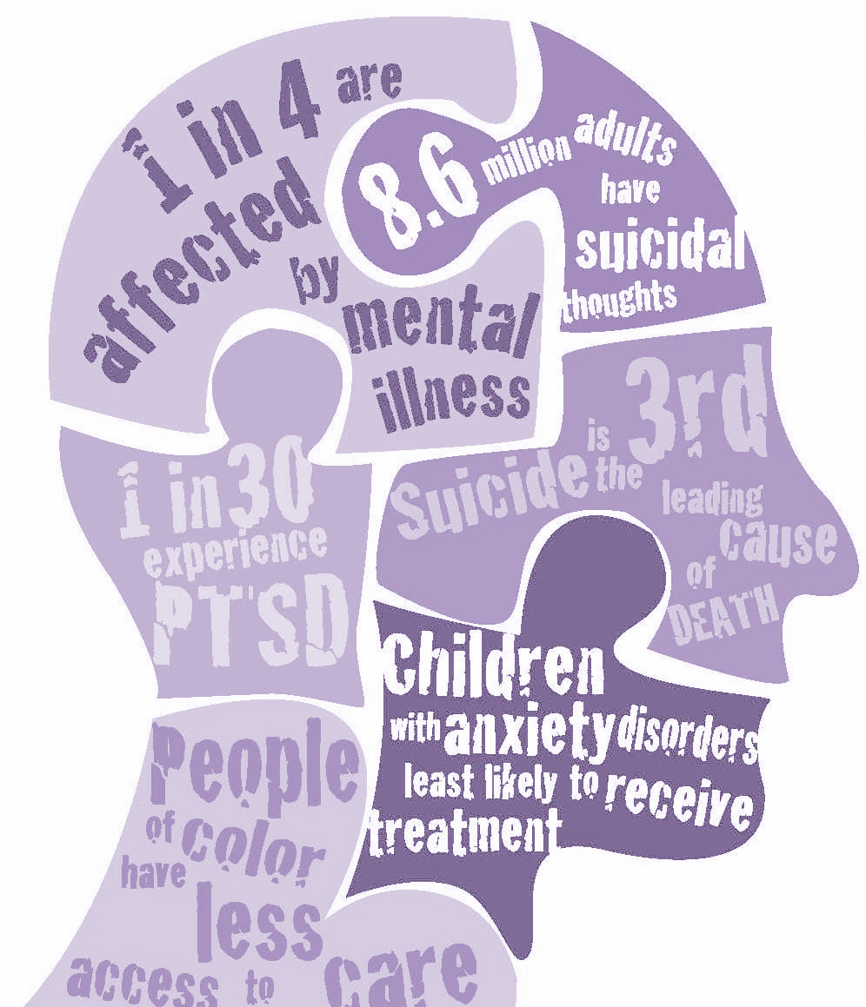
Mental Health
So Important, yet widely misunderstood.
No real solutions offered.

Slide 3
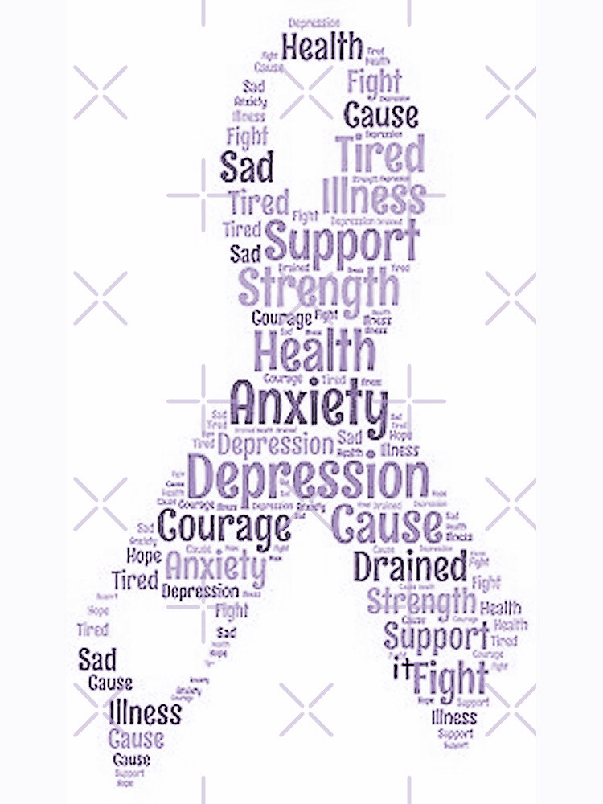
Mental Health
Plenty of stigma, people question its validity.
“Tainted existence.”
Unhealthy coping mechanisms.

Slide 4
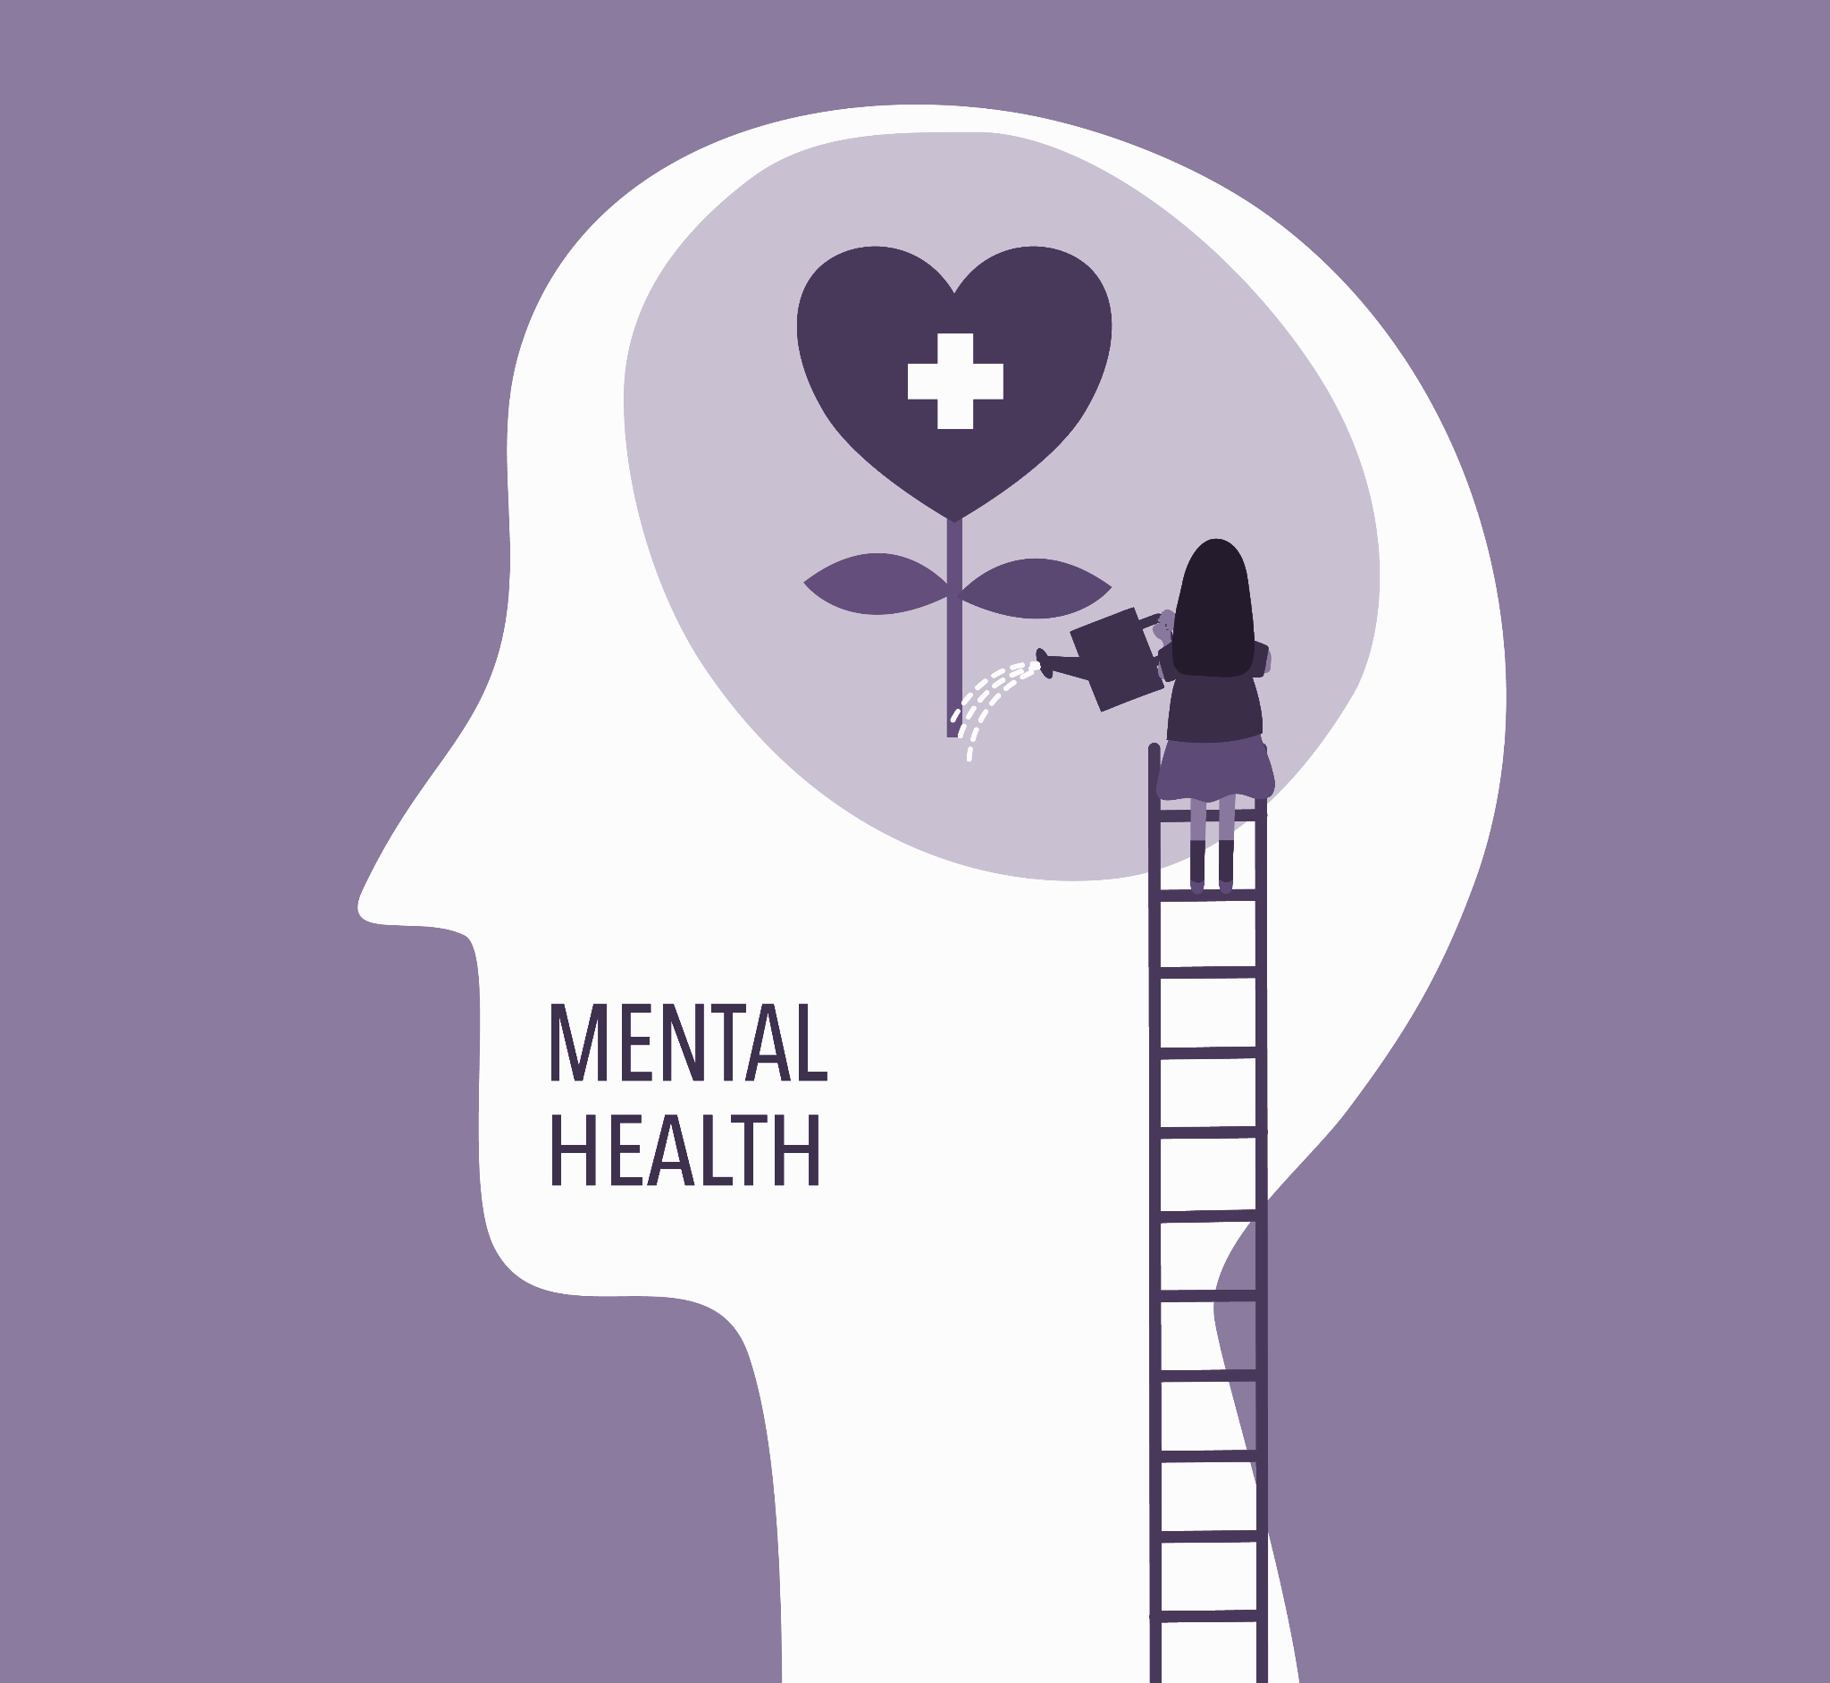
Mental Health
Self-harm and suicides on the rise.
Therapy is costly.
Overwhelmed Therapists.

Slide 5

OUR SOLUTION
We aim to gauge people's mental health and diagnose issues based on their activities and a custom test powered by AI to grasp the mental state of the patient.
The patient is further exposed to a series of tests that include, but are not limited to the media they consume, how their average day looks like and inkblot tests which help an ML model predict the mental well-being of the patient.

Slide 6

OUR SOLUTION
Based on the results the patient is then introduced to therapy which will be handled by a chatbot with real-time analysis providing effective responses. The net outcome ranging from an elevated mood to feeling mindful about the present and hopeful about the future.
In the unlikely event that the condition of the patient is found to be extreme (suicidal), the suicide helpline shall be informed about the patient’s state along with their portfolio.
We intend to help people fight their demons one step at a time.

Slide 7
THANK
YOU!

